Slide 1



SVNV@dps.state.nv.us
safevoiceinfo@doe.nv.gov
Don Johnson
Field Representative
775-267-7796
Sgt. Desiree Mattice
775 684-2587
775 301-0961 cell

Slide 2
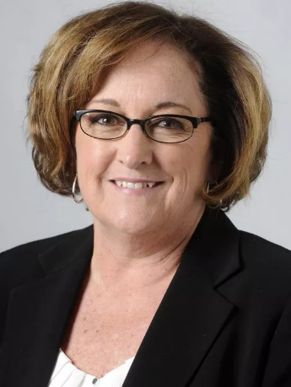

Origin and Purpose
2015 Session of the Nevada Legislature: Senator Debbie Smith and Senator Heidi Gansert introduced legislation that led to the development of SafeVoice
Senate Bill 338 (July 10, 2015): Advisory Committee to study tip systems
Senate Bill 212 (June 12, 2017): K-12 Tip reporting required by law
PURPOSE: Empower Nevada youth to actively engage in school and student safety and well-being
Smith
Gansert

Slide 3
NRS 388.1451
Establishment of SafeVoice in Nevada Law
NRS 388.1454(3) (Safe-to-Tell) (i.e. SafeVoice)
  It is the intent of the Legislature in enacting NRS to 388.1451 to 388.1459, inclusive, to enable the people of this State to easily and anonymously provide to appropriate state or local public safety agencies and to school administrators information about dangerous, violent or unlawful activities, or the threat of such activities, conducted on school property, at an activity sponsored by a public school or on a school bus of a public school.

Slide 4

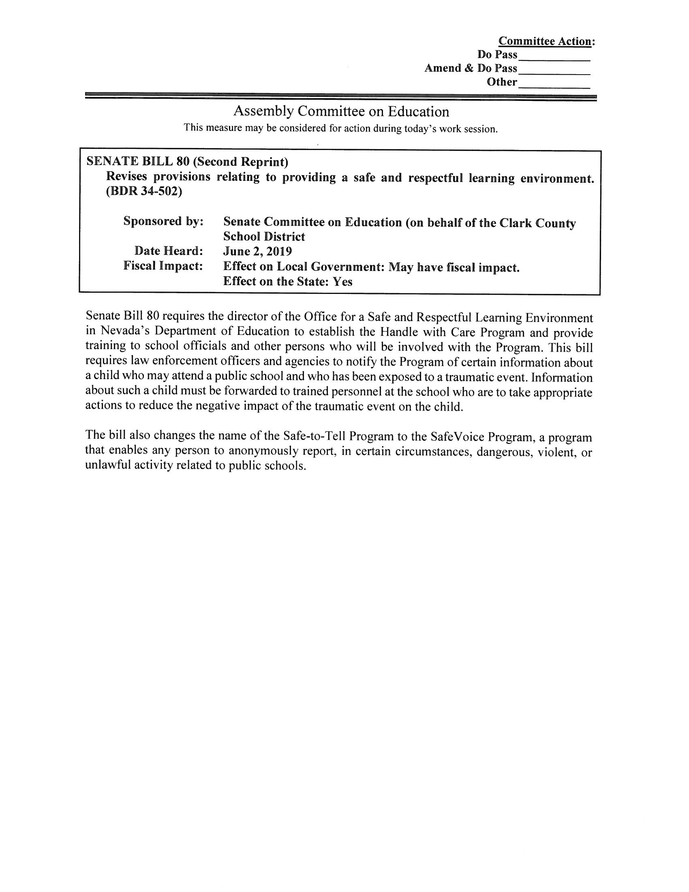
SB 80: Handle with Care:
Student Safety – New Law

Slide 5
Handle with Care
Any officer or employee of a law enforcement agency who, in his or her professional or occupational capacity, knows or has reasonable cause to believe that a child who may attend a public school has been exposed to a traumatic event shall submit a report to the Handle with Care Program …

Slide 6

Handle with Care
Traumatic events include;
  Domestic Violence in the presence of the child
  Death of a member of the family or household of the child
  Arrest of a parent or guardian of the child in the presence of the child or
  Child abuse or neglect

Slide 7

Confidentiality of SafeVoice
SafeVoice confidentiality is much like
Fight Club
What is the first rule of Fight Club?
Many school personnel and law enforcement continue to advise the students that a SafeVoice tip was submitted about them.

Slide 8
Confidentiality of SafeVoice Information
NRS 388.1458:
Confidentiality:
Except as otherwise provided in this section or as otherwise authorized pursuant to paragraph (a) of subsection 2 of NRS 388.1455, a person must not be compelled to produce or disclose any record or information provided to the Safe-to-Tell Program (now SafeVoice).

Slide 9
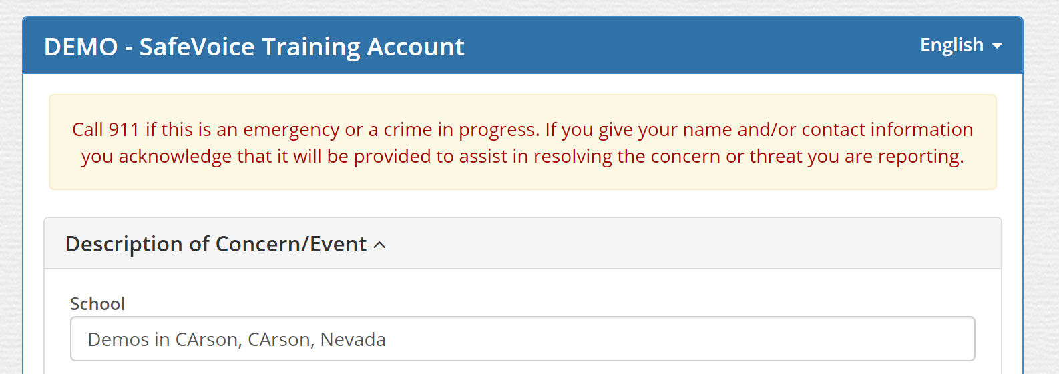
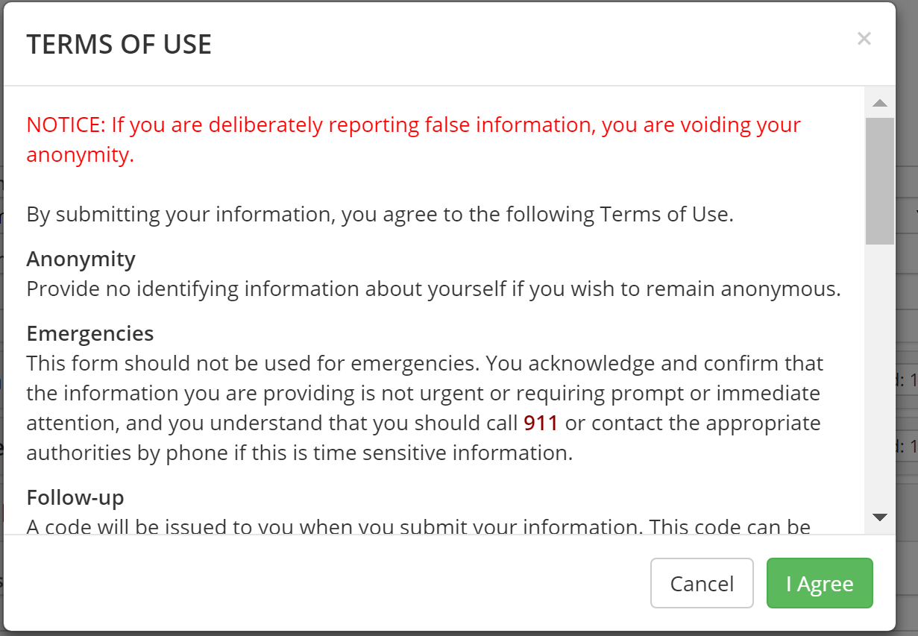
Governor Sandoval signed Emergency Regulation 7.22.18
← Resolve Self-Report and Anonymity
Deter Pranks →
And Harassment

Slide 10

SafeVoice is now a requirement for all public schools per NRS (SB212 of 2017 session), also
It’s undeniable, many of our students are facing emotional and mental health challenges, and our schools are faced with threats to student, staff and school safety
SafeVoice is an Early Warning System and a PREVENTION, INTERVENTION, and SUPPORT Tool for the whole school community
WHY bring on SafeVoice?
The Why: Save lives. Power learning.

Slide 11

What is
A 24/7/365 tip reporting system for concerned students, parents and community members using hotline, web report or mobile app
Reports go to trained communication specialists at the Department of Public Safety (DPS), and reporting party is given a tip ID and a password to use to log back in with more info or to receive questions from SafeVoice Communications Specialists
Reporting information is passed on to local law enforcement in the case of an emergency or criminally-involved situations, as well as to the school-based team depending on situation.
SafeVoice tracks the progress and outcomes of all reports forwarded through required disposition reporting within the P3Campus SafeVoice technology platform.

Slide 12

A word about
Safe and Respectful Reporting
SafeVoice is here to:
It is not for:
Protect students from bullying and school violence
Help students speak up for their friends & themselves
Help parents who have already spoken directly to teachers and principals, yet feel they have not been heard
False reports, peer conflict, or pranks
Complaints and grievances that are not related to school safety and student well-being
These take life saving time from the Comm Center
Harassing other students or adults in the school
False and malicious reporting can cause reporter to void anonymity

Slide 13
Nevada’s Approach to Tip Reporting
Theory of Change
Safe Schools +
Student Care +
Student Empowerment =
Positive School Climate → Student Success
SafeVoice is another door in the No Wrong Door approach to school safety & student wellness
When students go through the door, a system of supports is waiting for them

Slide 14
The Process
School Team
receives report and responds timely during school hours
Active suicide risk also to Law Enforcement 24/7
Active threat of school violence or suicide to Law Enforcement 24/7
DPS receives reports live 24/7; two-way dialogue when reporter logs back in

Slide 15
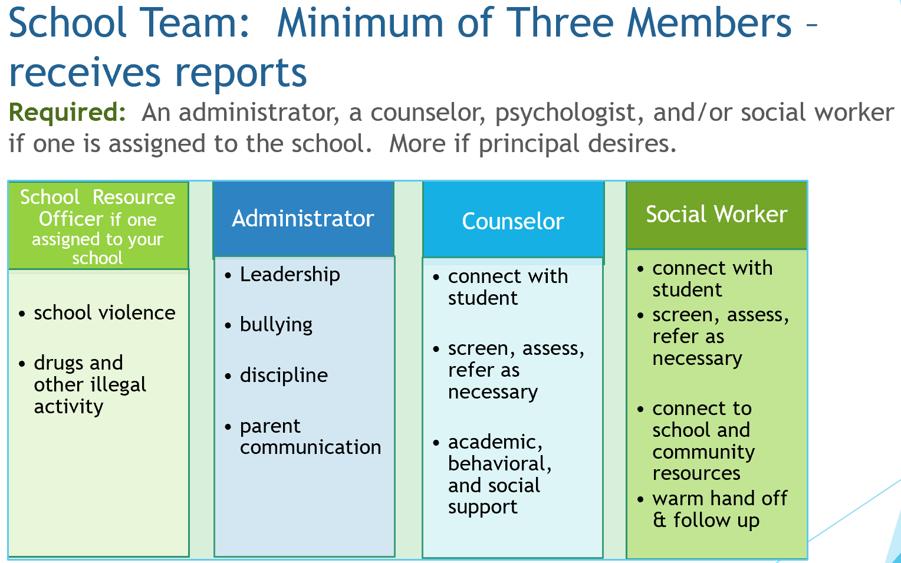

Slide 16
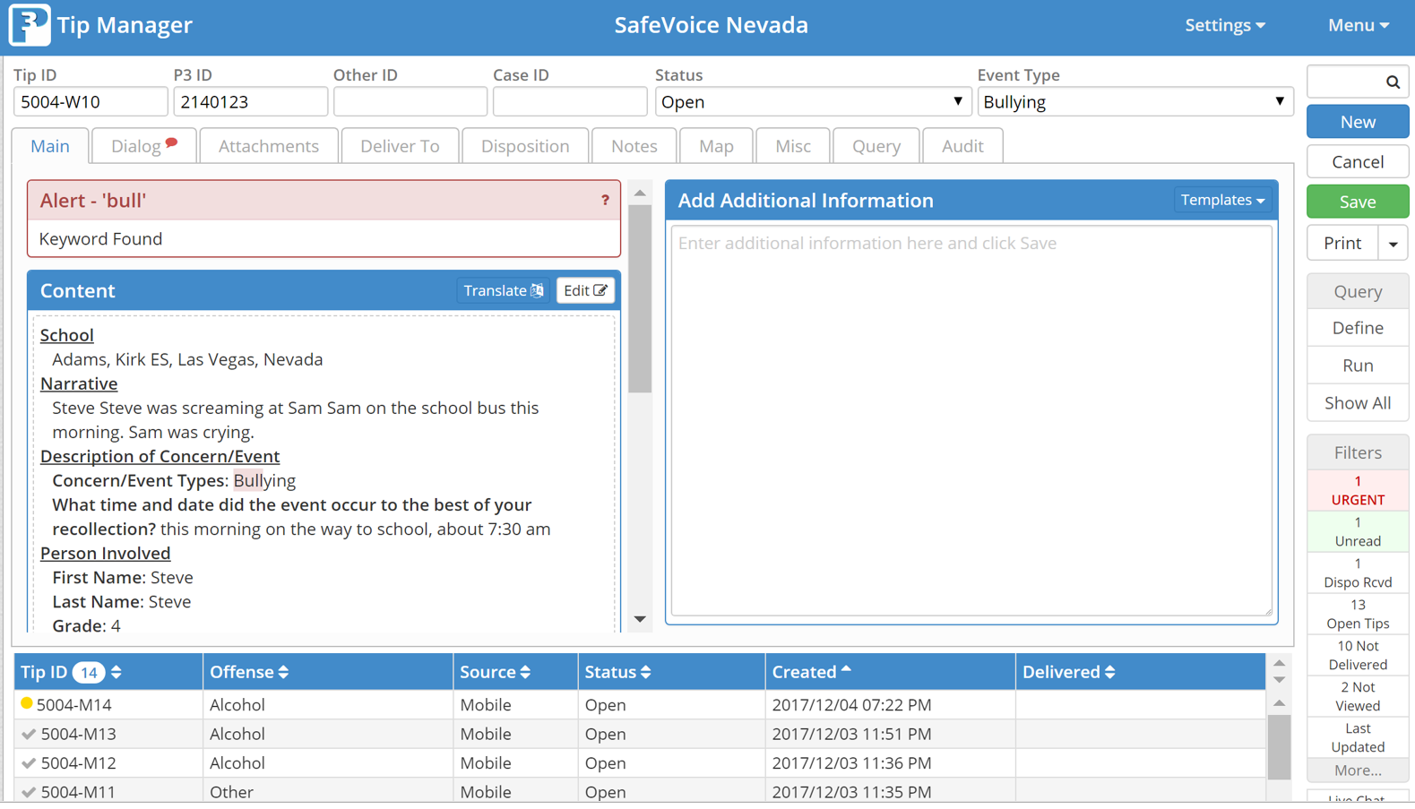
How does it work? REALLY WELL!
P3campus.com – team member logs in to see and dispo tips
P3 encrypts reports so reporter is anonymous; phone number, IP address, location are not known. Reporter may choose to share name and contact information to assist in resolving concern, whether it is a self-report or as a witness to an event, or a friend concerned for another friend.

Slide 17

3 Ways to Tip
Use the launch lesson
Use the rack card, post classroom and hallway posters –Ask about the bus decal!!

Slide 18
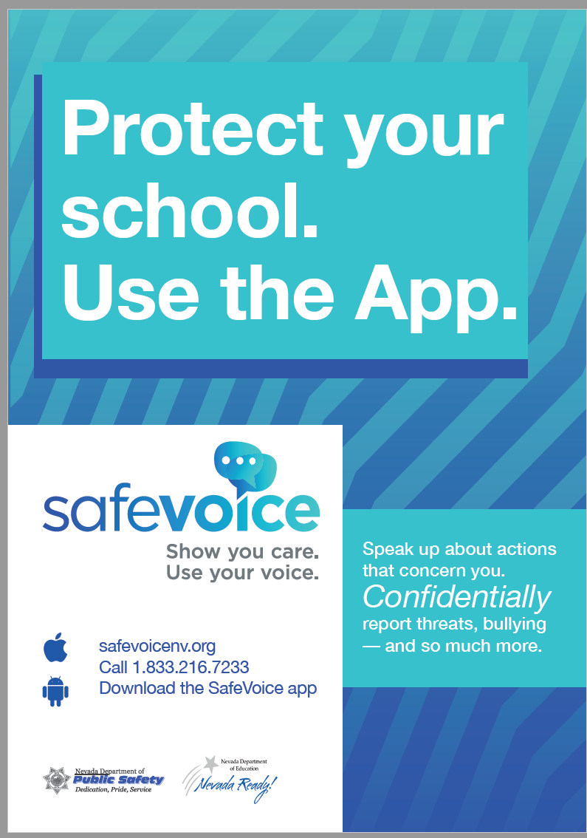

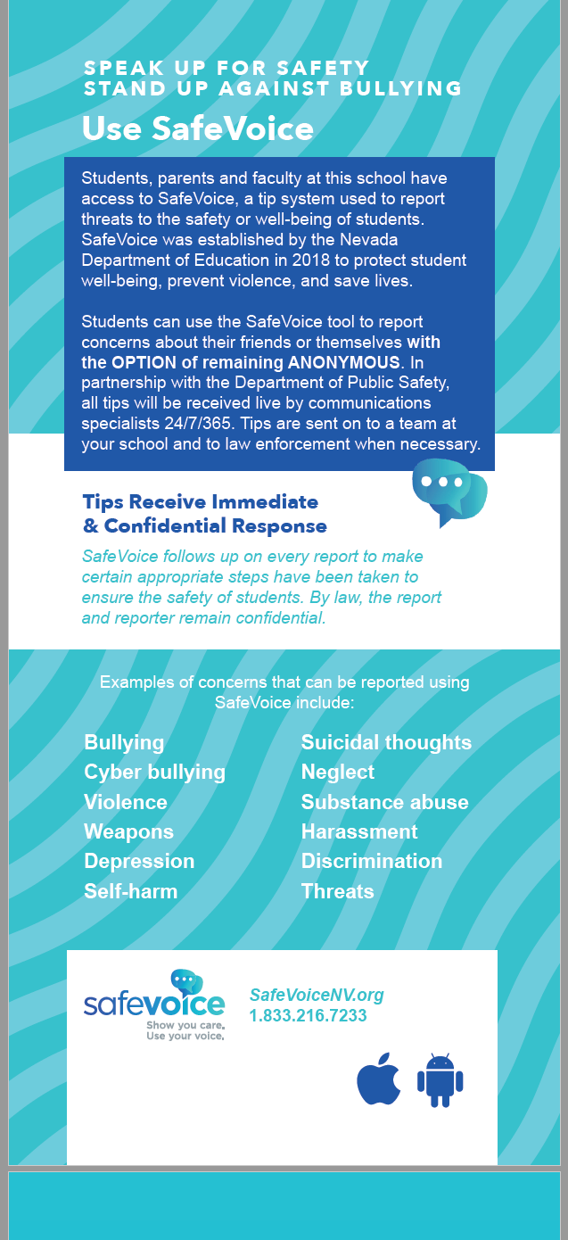

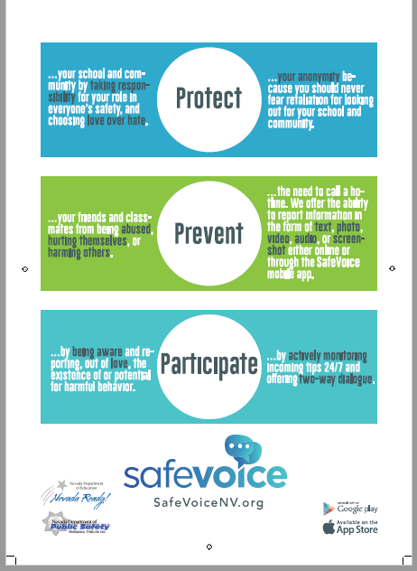
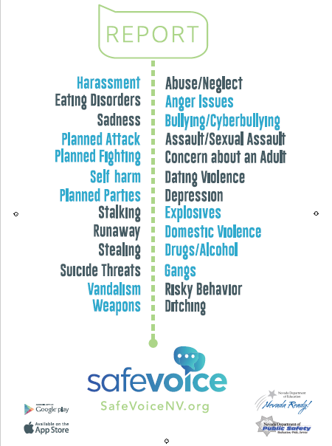

Rack Card,
English and Spanish
← Hallway Posters →
Applaud students for standing up for each other and themselves, for owning school climate and safety
Classroom posters

Slide 19
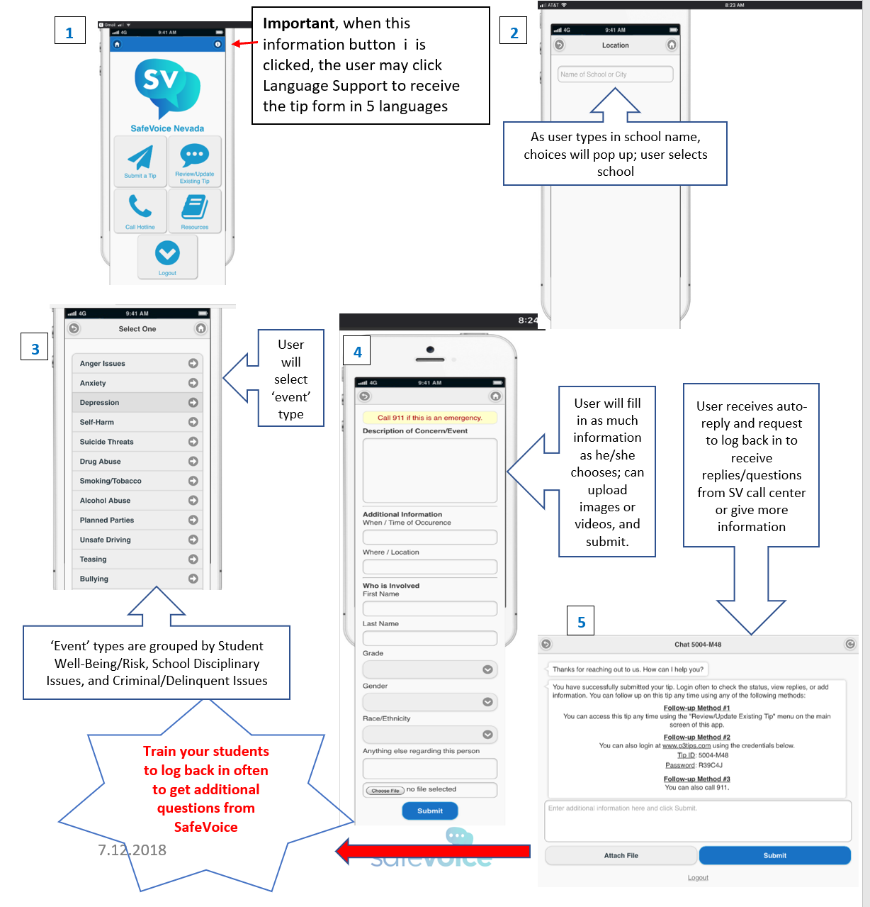
Using the Mobile App
Download from app store – FREE
Click Submit a Tip NOTE: upper right corner language (Spanish) dropdown
Type school name, will auto-populate
Select Event Type
Describe event, more information in drop downs NOTE: student must use name to self report!
Submit and screenshot tip number and password. LOG BACK IN to dialog with DPS

Slide 20
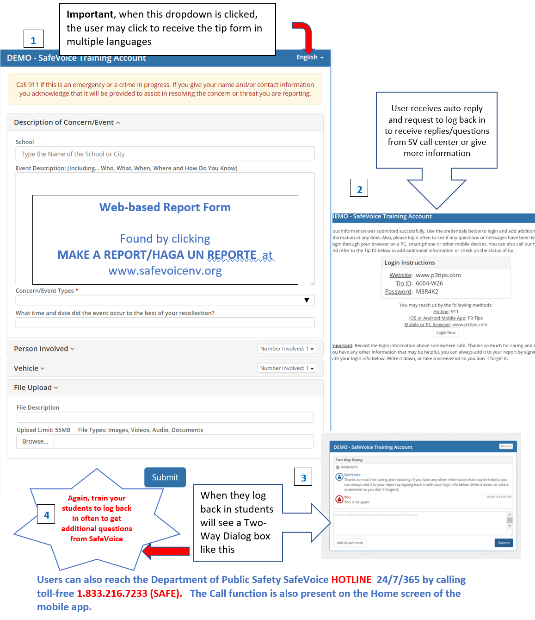
Reporting from www.safevoicenv.org
Same process
Language choices in upper right corner
Log back on to answer questions from DPS Comm Specialist or to give additional information

Slide 21
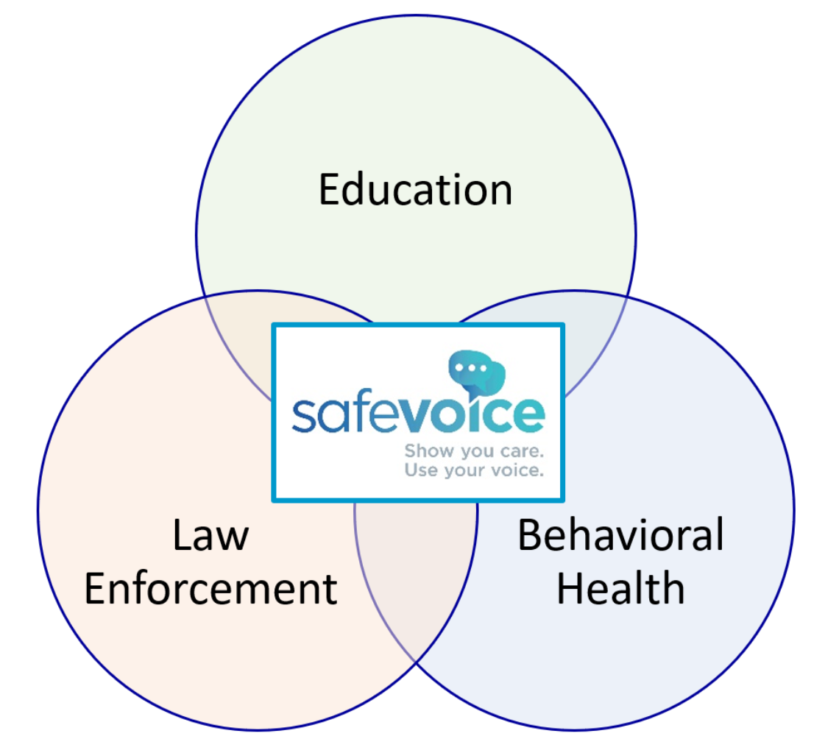
Intent: Safety & Well-Being
Outreach and awareness is Education-led
Tip processing is led by Law Enforcement (DPS)
Response is from all three partners, including community partners; parental involvement is key
Use of SafeVoice platform to communicate
Partnership supports collaboration to keep students safe

Slide 22
The Process
SafeVoice Tip
received by DPS,
live 24/7, two way dialogue,
Priority Level set, tip sent out
The Roles
School Team
receives all reports and responds during
school hours
(some tips may be special circumstances on how the tip is sent to the School, District or Charter/Public School Recipients
Active threat of school violence, suicide threat, life-safety matter or criminally involved reports
go to law enforcement 24/7
Law Enforcement takes actions as deemed necessary
Priority levels and event types are based on information received, however, they are subject to change as more information is obtained
If tip is regarding “bullying” investigation & required timeline begins
NRS: 388.12/ 388.123
Schools provide appropriate resources as deemed necessary
Law Enforcement provides update in P3 (CAD#; welfare check; investigation; contact made; etc.)
Does not close tip
School team provides update in P3 (disposition, actions outcomes, additional information) closes out the tip

Slide 23


Multi-Disciplinary Approach: Roles
. SafeVoice is a partnership between the Nevada Department of Education and the Department of Public Safety.
. School Police and local Law Enforcement respond to ALL threats to life and safety.
. School Multi-Disciplinary Teams (MDT) respond to ALL tips with student support and referrals to school- or community-based services.
. School social workers, counselors and psychologists work with students to keep them safe, resolve problems and increase resilience.
. Mobile Crisis Response Teams (MCRT) assist law enforcement to meet the urgent needs of students in crisis.
. Local Behavioral Health providers work with school professionals to meet the mental health needs of students referred for evaluation and treatment.
PARENTS AND STUDENTS:
OUR MOST IMPORTANT PARTNERS

Slide 24
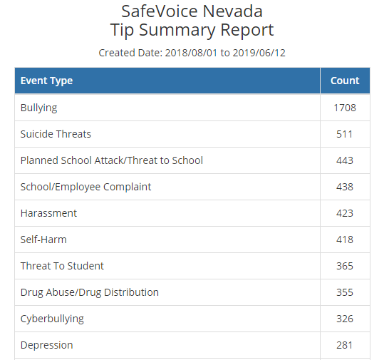
SafeVoice Summary of top 10 for first full school year 2018/2019

Slide 25
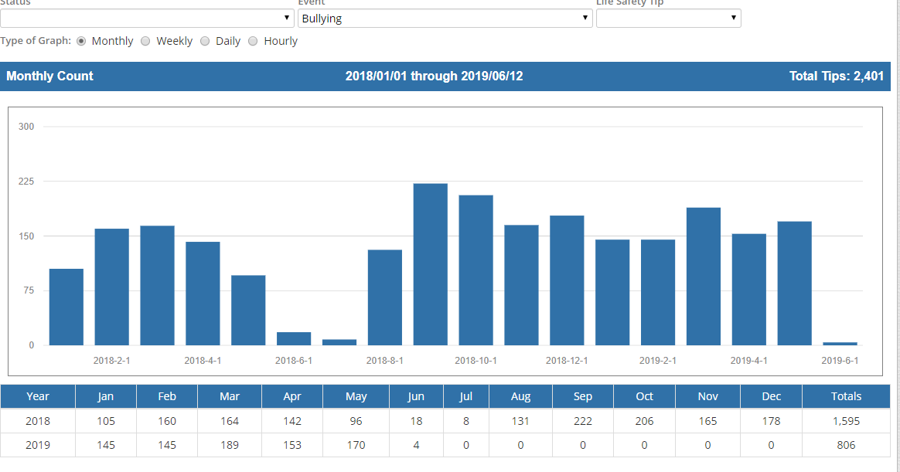
Monthly Activity for Bullying Tips

Slide 26
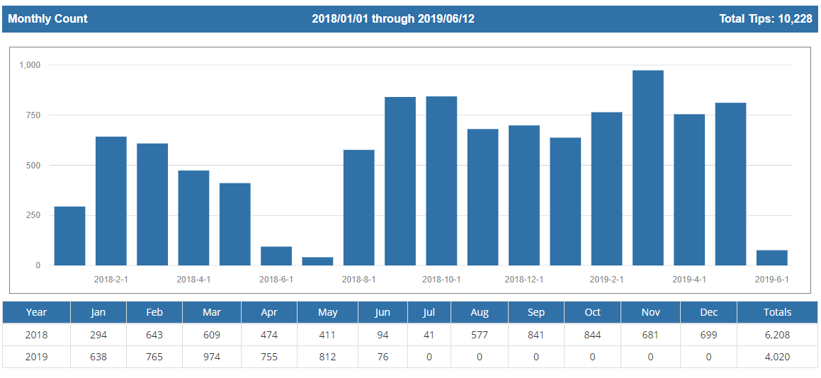
Monthly Activity Of All Tips Received

Slide 27
Interesting Information and Trends Noted During 2018
Between August 2018 and December 2018, 4 students were reported as having committed suicide in Nevada.
Nevada currently ranks 6th in the United States for suicide rates per capita
Suicide is the second leading cause of death of students 15 and older (traffic accidents are currently first leading cause)
source: https://www.americashealthrankings.org/explore/annual/measure/Suicide/state/NV

Slide 28
Interesting Information and Trends Noted During 2018
During the first semester of school year 2018-2019 (August – December)
  SafeVoice received approximately 3,500 tips
  Approx. 39% of cyber-bullying was conducted using social media posts to threaten, intimidate, or harass another student.
  1,983 tips (approximately 57%) were reported during school hours
  (7 a.m.—3 p.m.)
  Middle school students (grades 6 through 8) represented the largest population of individuals identified as perpetrators in school safety reports

Slide 29
Progress
Since the SafeVoice Communication Center and its program started January 1, 2018 to June 16, 2019 (0730hrs) there have been 10251 tips received.
Of the tips received, 3,141 tips were sent to some type of Law Enforcement Agency. (Sheriff’s Office, local Police Department, School Police)

Slide 30

A message from David King, an Assistant Principal in Colorado about Safe2Tell, which uses the same technology and similar approach as
Thank you! for all the care you share with Nevada’s students!
https://goo.gl/images/p7f2vk
For MS and HS faculty, this is in your launch lesson ppt, PLEASE share with your students! And finally,

